Slide 1
PWM-Controlled SSD Cooling Fan using DHT11 and Arduino
Team - SPARKHUB
Simple and easier set-up and build for BEGINNERS
LOW COST AND DIY PROJECT TYPE IMPLEMENTATION

Slide 2
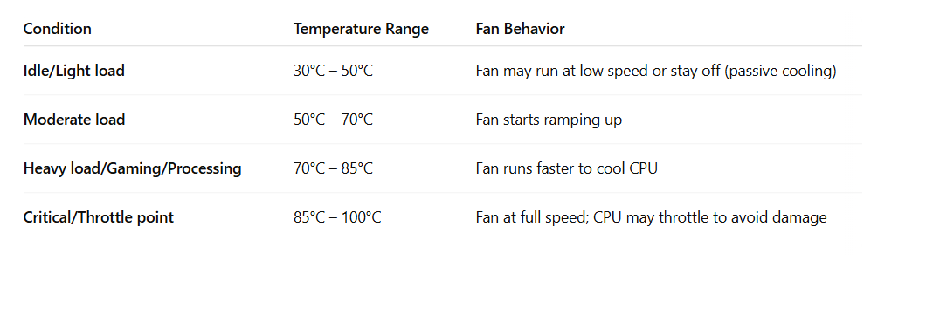
INTRODUCTION :
This project aims to implement a temperature-based automatic fan speed control system to cool an SSD efficiently.
DHT11 sensor combined with IRF520 MOSFET and Arduino is used to monitor temperature of the cpu, gpu or other system and run the cooling fan effectively as they consume some amperes per day.
This utilizes a simple loop structure and avoids heavy algorithms for simple home desktop applications.
Note :
Owing to DHT 11 temperature sensor range of only 0-50*C the implementation is narrowed down to 40*C /other sensor with range -50-150*C can be used.

Slide 3
Block Diagram :
CPU / GPU or any solid-state device
Cooling fan
(12V/0.2A)
>=14V & 4A
Buck Converter
12V / 0.2A
+
-
MOSFET
DHT 11
ARDUINO
Ideal :0-100*
Now: 0-50*
Interpolation
PWM pulse
0-100% duty at 5V

Slide 4
Working :
The higher voltage from Intermediate bus converter/>2A output is given to a buck converter which outputs 12V and 0.2A connected to the positive terminal of the cooling fan.
The temperature reading from the sensor is fed to the Arduino input pins and based on the temperature range ,
interpolation formula is used to map the values and generate the PWM waveform.
This is given to MOSFET drain which now acts as switch with its source terminal connected to ground.
This is connected to the negative terminal of the cpu fan which helps to vary the speed of the fan.
Note:
At 100% PWM , average output voltage from MOSFET and + will be 12V
At 50% PWM , average output voltage will be rounded to 6 V .
Challenges :
Dust accumulation on the Cooling fan can sometime cause cpu fan to run faster or reduce its performance . So fully automated system can affect other components.
Separate space for small wiring connection is required.

Slide 5
Conclusion:
In this project, we demonstrated how using Pulse Width Modulation (PWM) for motor control in a simple, low-cost setup provides an effective solution for managing CPU/GPU fan speeds.
By adjusting the fan speed to match the average power demand, we ensure smoother operation without frequent start/stop cycles, which would otherwise cause unnecessary wear. This method is particularly advantageous for predictable CPU/GPU loads, providing efficient and reliable cooling with minimal complexity.
Furthermore, the system can be extended to handle varying AI loads, offering scalability and adaptability while maintaining low energy consumption and prolonging the lifespan of components.
Team members :
1, Poovannan V.P.(220901070)
2 , Pranav Aravindhan V(220901071)
3, Nitin V.H(220901066)
4, Rohan Sanjay(220901083)

